Slide 1
EVENT PLANNING SYSTEM
Participants
1.Doreen Mushi
2.Stella Kapinga

Slide 2
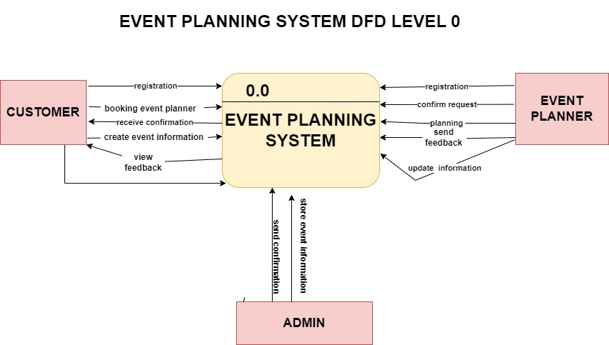

Slide 3
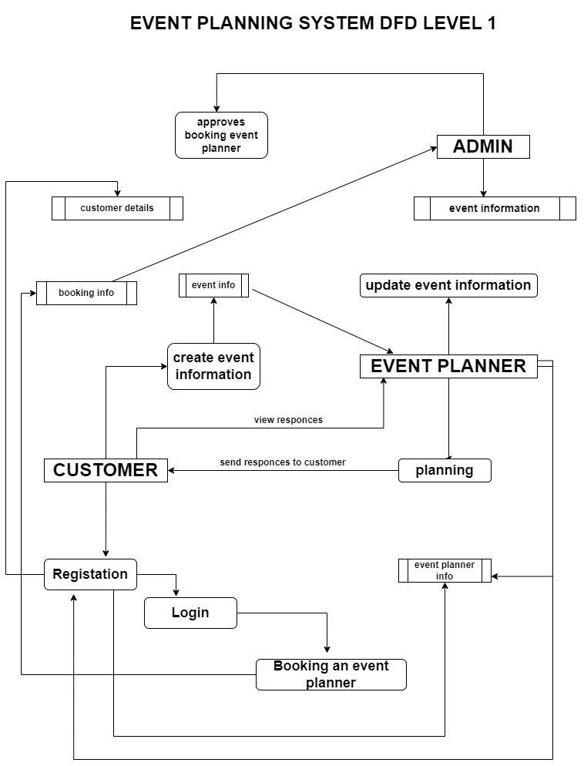

Slide 4
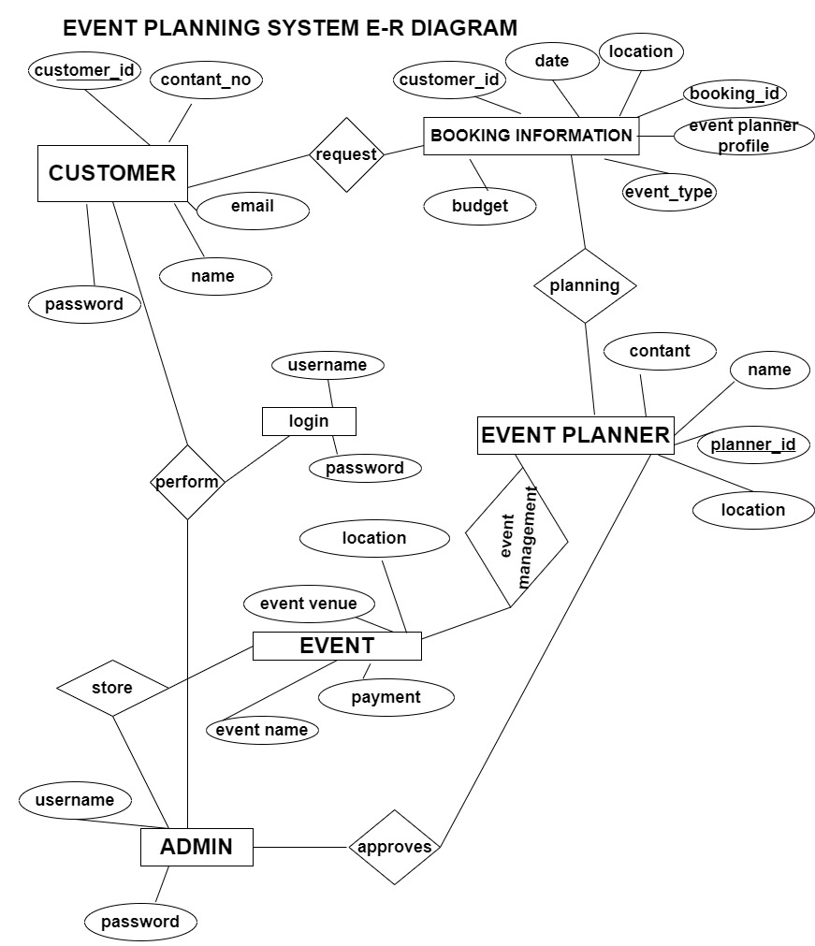

Slide 5
